Slide 1
Demographics Reporting
Tutorial for Public Services Organizations receiving CDBG funds through City of Chico
City of Chico Housing
MaryJo Alonzo – Housing Specialist
Jamie Hernandez – Admin Analyst

Slide 2
Introduction
What, why and how to report required information

Slide 3
HUD reporting requirements
Regulations
  24 CFR 570.503(b)(2) – requires recipient to execute agreement with Subrecipient which includes reporting requirements
  24 CFR 570.506 – sets specific data requirements for use of CDBG funds to confirm eligibility determinations
Demographic Data
  Income information by family size
  Household characteristics (Female HH, Senior, Disabled)
  Race and Ethnicity information
Purpose
  To accurately assess the effectiveness of programs and progress toward stated goals (internal and external)
  Better informed decisions regarding ongoing impacts of funding allocations
Methods
  Exhibit E data table
  PDF => Excel
Results
  Uniform, streamlined process that is more accurate and more effective
  Accomplishment Dashboard
  Activity Expenditure Dashboard
  Performance Profiles

Slide 4
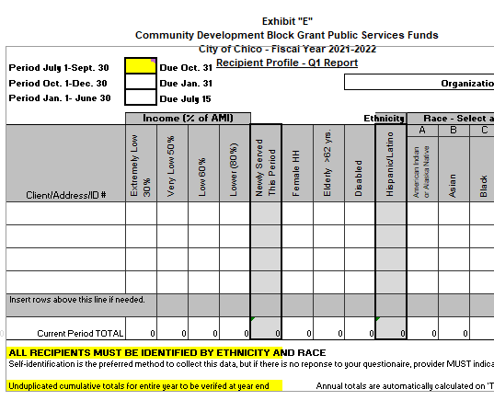

Mostly same look – All new features
You are probably used to seeing this Exhibit E, either in .pdf or Excel. This version is the final step in streamlining the reporting process.
This version allows for all quarterly reports to be managed in one workbook for the entire fiscal year.
You will continue to submit quarterly by emailing your workbook to Housing Staff
The data is consolidated on the summary sheet for the year-end reporting.
Tables are dynamic and will let you know if certain items are missing or inconsistent.

Slide 5
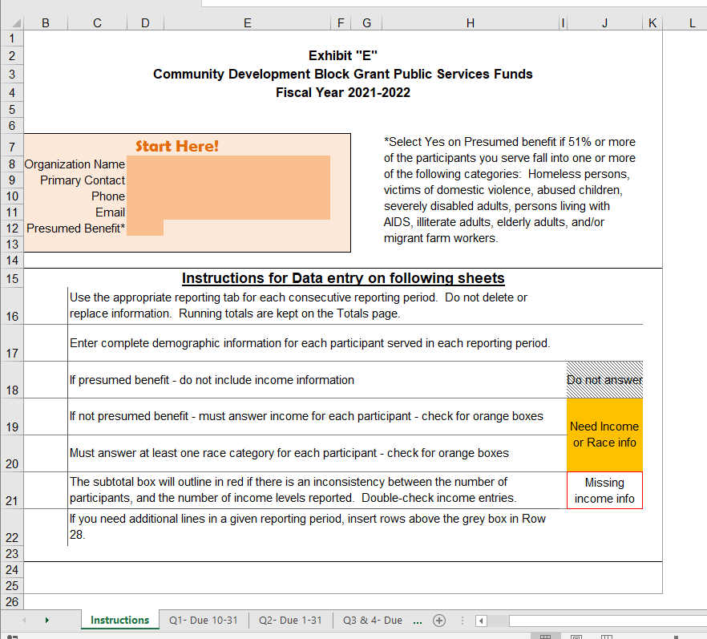
Essential Information
The first tab is for essential identifying information must be completed prior to entering data further on.
There are also helpful hints if you get stuck anywhere. Refer back here as often as you need!

Slide 6
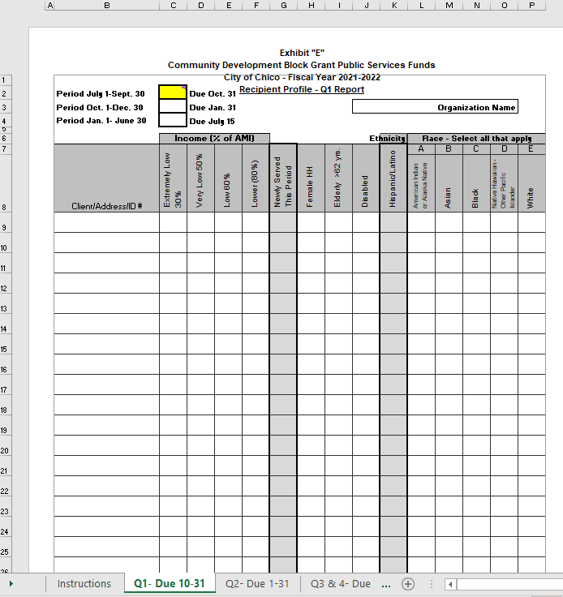
Data Entry
1. Each Reporting Period (Quarter 1, 2 or 3/4) will have it’s own tab that is completed and saved. The cumulative end result will serve as an annual report.
2. Please note the simplified Race categories.
3. For each individual, you must answer the income section and at least one race category. Other items may be answered as applicable.
4. Once table is complete and reviewed, add initials or date submitted to yellow box.
1. Quarterly reports

Slide 7
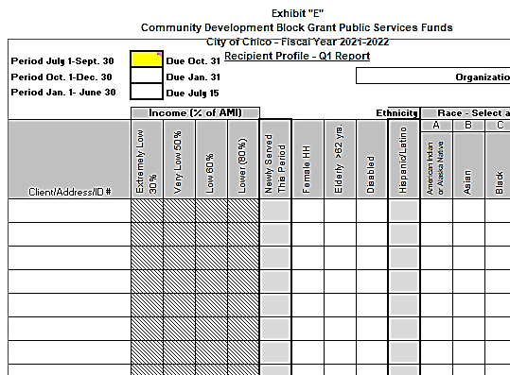
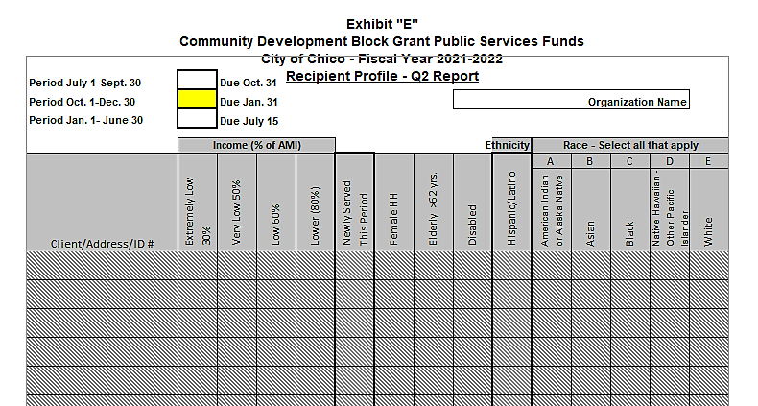
Automatic shading
Depending on selections and progress, you may find certain cells shaded.
If you selected “Presumed Benefit”, you will not need to answer Income information.
Reporting periods will be shaded until the prior period is completed.

Slide 8
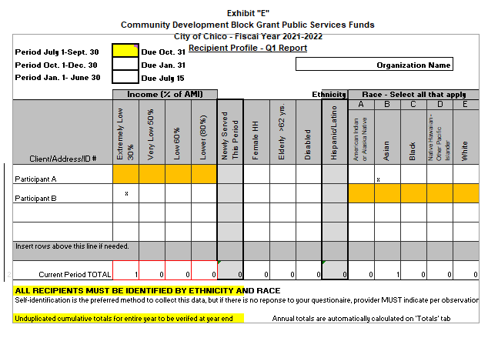
Recognizing Errors
Table is dynamic and will highlight any items that still need attention.
If Income or Race information is missing for any individual, the fields will highlight ORANGE.
Subtotals will outline in RED if any of the subtotals are inconsistent.

Slide 9
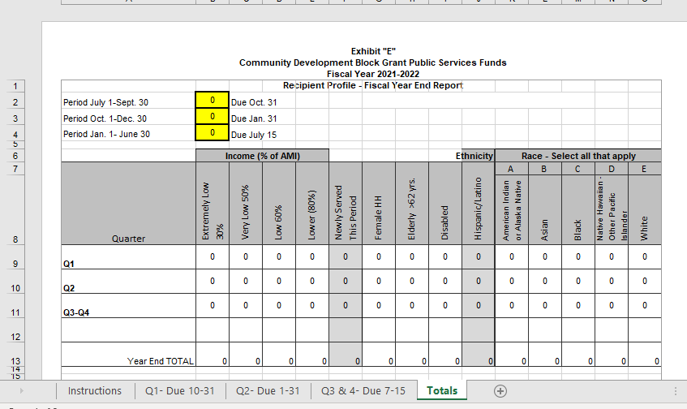
Summary
For review only!
Do not adjust any items here.
At the end of each quarter, please review totals here for accuracy.

Slide 10



Questions Comments
We would welcome any feedback at this time.
Also feel free to reach out to us at your convenience!
MaryJo: 530-879-6302 Maryjo.Alonzo@chicoca.gov
Jamie: 530-879-6304 Jamie.Hernandez@chicoca.gov

